Slide 1
Restaurant Consumer Segmentation
UCI Restaurant and Consumer Data | R segmentation, driver modeling, and concept scoring

Slide 2
What the analysis is designed to answer
Which consumer segments are present, what restaurant concepts rate best within them, and which measurable features are most associated with high satisfaction?

Slide 3
Segment profile summary
Segment | Customers | Ratings | High satisfaction | Top interest | Top personality
S1: Quieter mixed students | 63 | 561 | 40% | Variety | Hard Worker
S2: Mobile social students | 32 | 264 | 46% | Variety | Hard Worker
S3: Tech-focused students | 43 | 336 | 43% | Technology | Thrifty Protector

Slide 4
Top observed concepts
Concept | Ratings | High satisfaction | Average rating
High | price | Full bar | Familiar | 44 | 52% | 1.30
High | price | Wine or beer | Familiar | 121 | 50% | 1.31
Medium | price | Wine or beer | Familiar | 142 | 48% | 1.26
Medium | price | No alcohol | Familiar | 387 | 44% | 1.25
Low | price | Wine or beer | Quiet | 17 | 41% | 1.24

Slide 5
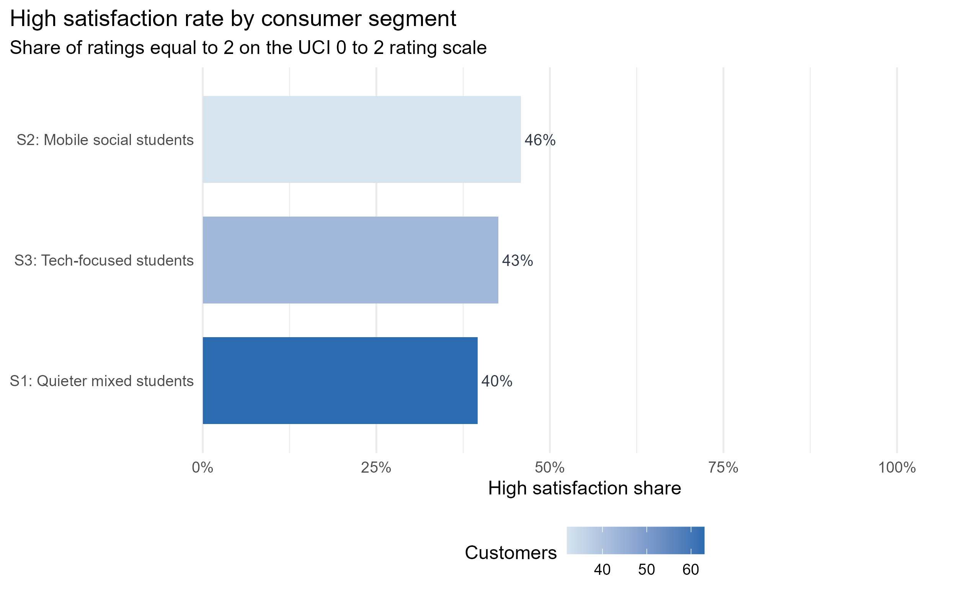
Segment satisfaction

Slide 6
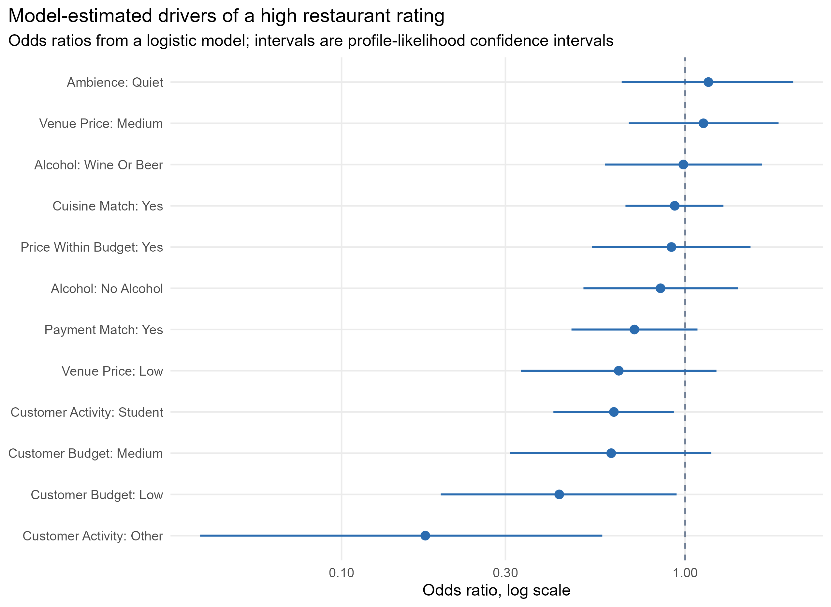
Multivariate drivers

